Slide 1
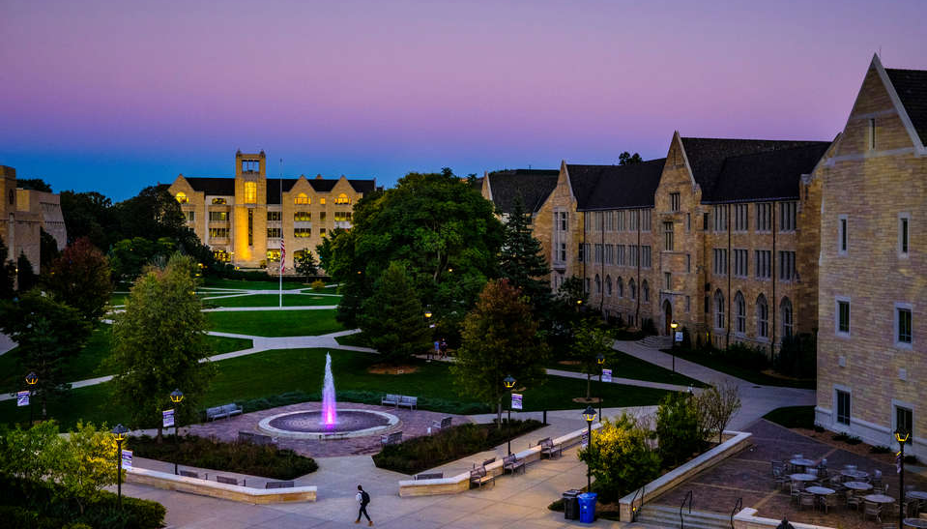
University of St. Thomas
$159,390,000
Revenue Bonds, Series 2024A, Series 2024B and Series 2024C
*Preliminary; subject to change.

Slide 2
Why Series 2024 Bonds? D-I Athletics
Strategic Priorities and Highlights | As the newest of the top 20 nationally ranked Catholic universities to join Division I, St. Thomas will emphasize comprehensive excellence to rise even higher among these peers and use Division I as a platform to increase its geographic footprint for enrollment The University of St. Thomas is one of a small number (11) of institutions nationally that are in the process of reclassifying to Division I athletics, and the only private university in Minnesota offering DI athletics On July 15, 2020 the NCAA grated permission to the University to move directly from Division III to Division I beginning in 2021 The Move to Division I athletics will help grow the University’s national brand and reputation and draw from a broader prospective student base nationally The University currently draws only 20% of students from outside the state of Minnesota Increasing out of state students will help drive profitability and financial stability As a new member in Division I athletics, the new arena project is the next step in the University’s strategic plan State of the art facilities will aid in the recruitment of top-tier athletes in Men’s and Women’s Hockey and Basketball Peer institutions with successful Division I athletics draw from national student populations with the percentage of out of state students ranging from approximately 50% to as much as over 80% The University’s goal is to better align with those peer demographics and increase net tuition revenue

Slide 3
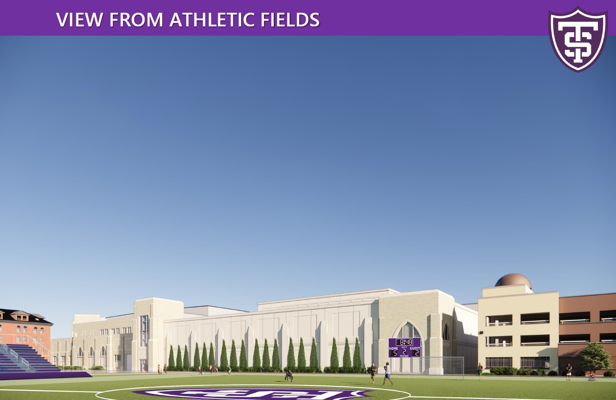
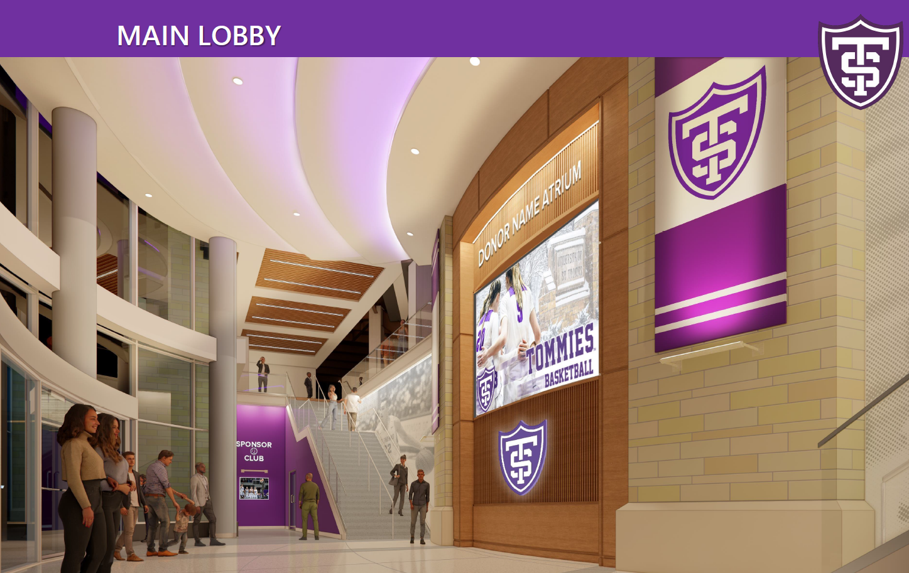
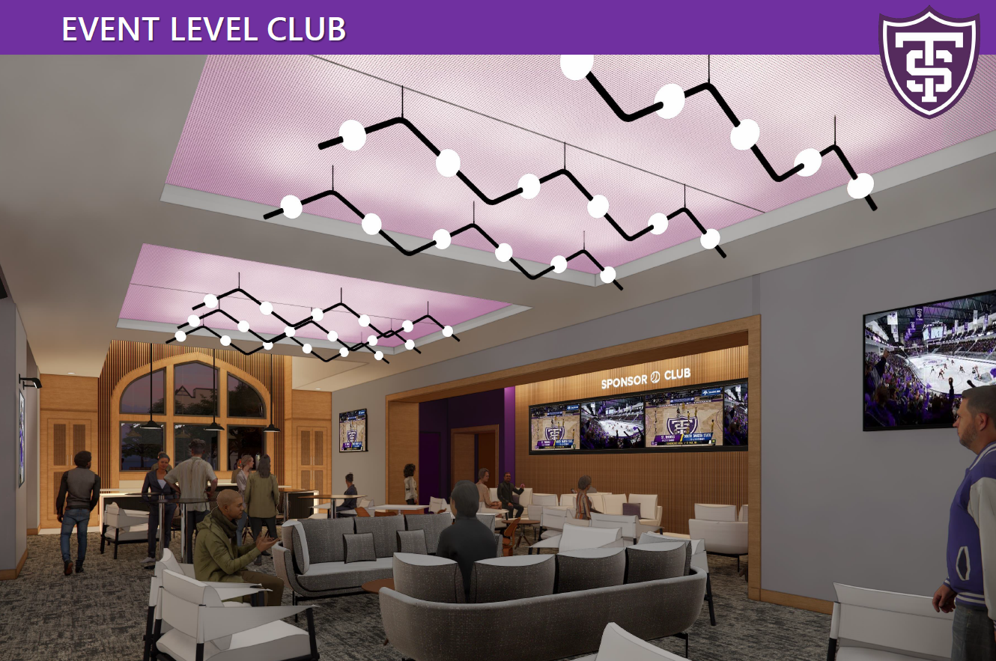
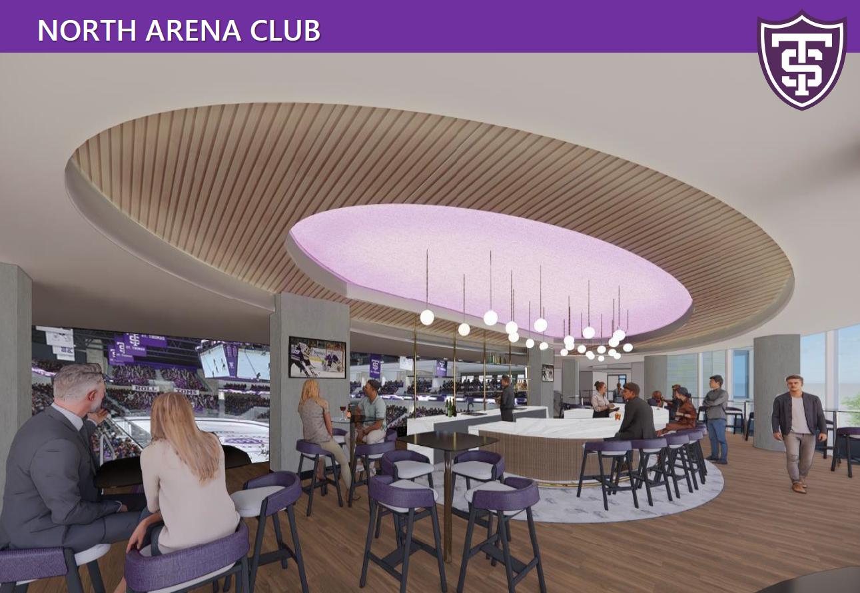
Series 2024 Capital Projects
Series 2024 New Money Proceeds
The Series 2024 bonds will be issued to finance the acquisition, design, site preparation (including demolition of existing improvements), construction, improvement and equipping of:
an approximately 270,000 square-foot multi-purpose arena including facilities for NCAA Division I hockey and basketball, other athletics, and other institution operations,
related higher-education facilities, and
other permissible capital projects
Arena Financing
Redevelopment of an approximately 6-acre site located on the South Campus in Saint Paul
Multi-purpose venue for both the Hockey and Basketball programs with a capacity for approximately 4,000 to 5,500 spectators
Practice facilities including two basketball practice facilities and an auxiliary ice sheet
Facilities will also include coaching offices, locker rooms and student athlete support services (sports medicine, strength and condition, etc.)
Ability to host other University events such as commencement ceremonies, academic convocations, speaker series, career fairs and other large events
Facility will be designed to meet a LEED Silver rating

Slide 4
Capital Structure
Capital Structure
$337,581,593 of debt outstanding as of 2/1/2024, including:
$310,890,000 of fixed rate amortizing debt
$26,691,593 of privately placed loans (variable, or fixed through mandatory tender dates)
The University has one fixed-pay swap outstanding with a current notional amount of $7.1 million which reduces annually. There is no collateral posting requirement
The University is assessing the most advantageous option for the Series Seven-Z to make a final determination between a capital markets refinancing, bank extension of the mandatory tender, or repayment with institutional resources
Outstanding Long-Term Debt
Series | Par Out (2/1/2024) | Type of Offering | Coupon Type | Final Maturity
Seven-U (2013) | 10,860,000 | Public | Fixed | 4/1/2027
Seven-Z (2014) | 11,706,593 | Private | Fixed to Mand. Tdr. 3/1/24 | 10/01/33
Eight-L (2016) | 42,880,000 | Public | Fixed | 04/01/39
2017A | 49,310,000 | Public | Fixed | 10/01/37
2017B | 1,325,000 | Private | Variable (Resets Quarterly) | 04/01/25
2019 | 76,840,000 | Public | Fixed | 10/01/44
2020A | 7,100,000 | Private | Fixed to Mand. Tdr. 7/1/27 | 10/01/32
2020B | 6,560,000 | Private | Fixed to Mand. Tdr. 7/1/27 | 10/01/30
2022A | 60,720,000 | Public | Fixed | 10/01/53
2022B | 70,280,000 | Public | Fixed | 10/01/53
 | $337,581,593

Slide 5
Series 2024 Plan of Finance
Arena Project
Project costs:
$183.4MM Total project costs
(19.5MM) Gifts on hand during construction
(7.9MM) 2022 bond proceeds
$156MM Project costs to be financed
Net Funding: Project costs will be net funded to reflect anticipated earnings on the construction fund
Private Business Use: Approximately $13.4MM of project costs will be financed on a taxable basis, subject to tax analysis related to private business use
Short Principal Feature: The University used a “soft put” structure for $50MM tax-exempt bonds
Achieve core objectives of the plan of finance, as well as optimize the University’s overall capital structure
Achieve a lower blended cost of funds given the current, elevated rate environment, and expectations for future interest rate reductions
Maintain flexibility to rapidly deleverage upon receipt of the balance of the “anchor” gift
Mitigate the impact any potential capital markets dislocation at the put date
Diversified principal amortization reflects further de-risking of the debt portfolio
Series 2024B Put Bonds principal to be split between two mandatory tender dates (10/1/27 and 10/1/29)
Bonds subject to optional call or mandatory tender up to 6 months prior to stated mandatory tender date(s)
The University will adopt a nimble approach to the capital markets, retaining flexibility to consider alternative structures should a change in conditions occur
Amortization: Balance of principal amortized for level debt service from FY 2031-2054, with taxable bonds amortized first
Optional Redemption: 8.5-year optional par call on 10/1/2032
Capitalized Interest: Through FY 2026
Series Seven-Z
The Series Seven-Z bonds are outstanding in the amount of $11.7MM, and are subject to mandatory tender on March 1, 2024
The University paid the Seven-Z Bonds with an increased line of Credit from USBank
Debt service on the refunding bonds is anticipated to be structured similarly to the refunded debt service; principal amortizes from FY 2025-2034

Slide 6
Series 2024 Project Example
Series 2024 New Money Proceeds
The Series 2024 bonds were issued to finance the acquisition, design, site preparation, equipping, etc. University of St Thomas multi-purpose Arena for Basketball and Ice Hockey. Required to comply with NCAA Division I rules.
The bonds were issued in three series
Series A – Serial and Term bonds - $94,440,000
Series B- Put Bonds, Green designated - $50,000,000
Series C – Taxable bonds, Green designated - $14,950,000
The project was “net funded” – construction period interest income would help fund project costs
Earnings will exceed bond yield by over 68 basis points (4.93% - 4.25%)
Gift proceeds are expected to fund Series B redemption
$75 million in lead gift, $25million received, $50 million deferred until death of donor
Taxable bonds sized to reflect projected private use over life of project

Slide 7
Series 2024 Bonds Sale Results
Series 2024 Sale Results
2024 Series C taxable bonds received strong investor demand and sold out quickly
2024 Series A long-dated term bonds sold out quickly and were oversubscribed. 2024 Series A serial bonds lagged
2024 Series B – Put Bonds initially drew little interest
During the order period –
Investors gradually placed orders for 2024C and 2024A Bonds. 2024B Bonds drew little interest initially
2024C Taxable sold out 1st, 2024A Terms sold out 2nd, 2024B sold out 3rd, 2024A Serials sold out last
2024A Final Bond Order results
Serial Bonds oversubscribed 1-2 times
Term Bonds oversubscribed 8.7 – 12 times
2024B Final Bond Order Results
Bonds oversubscribed 9.5 and 7.5 times
Final Repricing results
2024A Serial Bonds Reduced 1-2 basis points
2024A Term Bonds reduced 8 and 12 basis points
2024B Bonds reduced 9 and 7 basis points

Slide 8
Series 2024 Bonds Challenges
Series 2024 Sale Results
Were Green Bonds helpful?
Demand for Green Bonds was stronger than demand for non-green bonds (both tax-exempt and taxable)
New investors were attracted by Green designation and purchased bonds (Green and traditional bonds)
No interest rate difference between Green and Non-Green Bonds
How did 2024 Series B Tender bonds perform?
Performance exceeded expectations
Stronger demand than forecast
What were challenges to bond issuance?
Estimating reinvestment rates for net funding
Risk disclosure language –
Litigation
Timing of gift receipts
Green bond reporting
Future Challenges
Maintaining Green Status
SEC and MSRB Reporting Requirements
Future Private Use
Success of D-I Transition – NIL, Enrollment, Gifts

