Slide 1
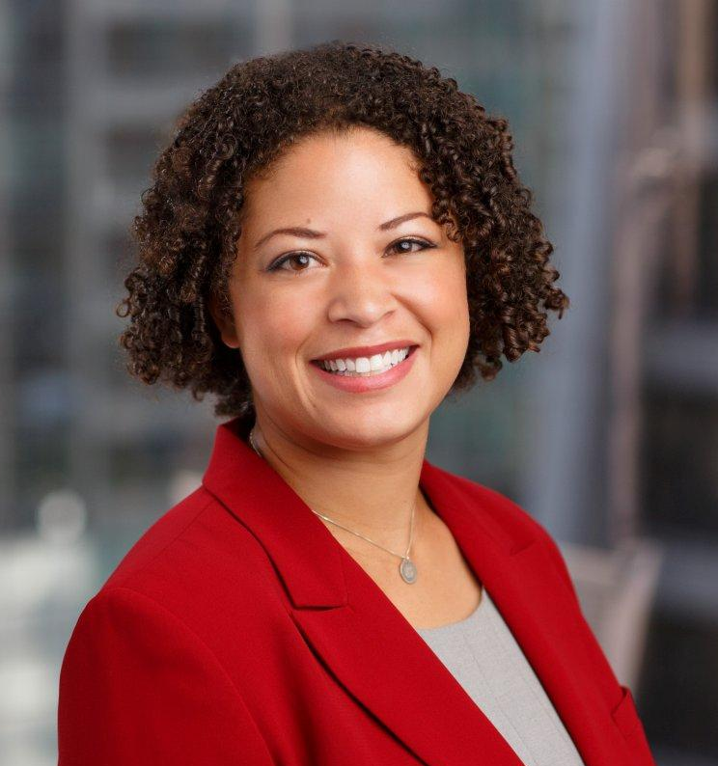
Contact
Emily E. Wadhwani (she/her/hers)
Senior Director, Education & Nonprofits
Direct: +1 312 368 3347
Mobile: +1 607 371 1194
emily.wadhwani@fitchratings.com

