Slide 1
Views from the Dismal Science

Slide 2
The Current US Economy
85% of economists forecast a 2023 recession
Nouriel Roubini’s forecast in 2022 was essentially that the Fed couldn’t raise interest rates in 2023:
Raising interest rates increases Government Interest Costs too much
So, Fed can’t manage inflation
A great test of Macroeconomic Theory

Slide 3
Old School Economics (simplified version)
Government spending rises (no tax increase)
National saving falls
If the Fed sells the debt
Interest rates rise crowding out private saving
If the Fed buys the debt
Increases money supply -> Inflation
Fed must soon combat with increased interest rates
Mixing Fiscal and Monetary Policy a bit

Slide 4
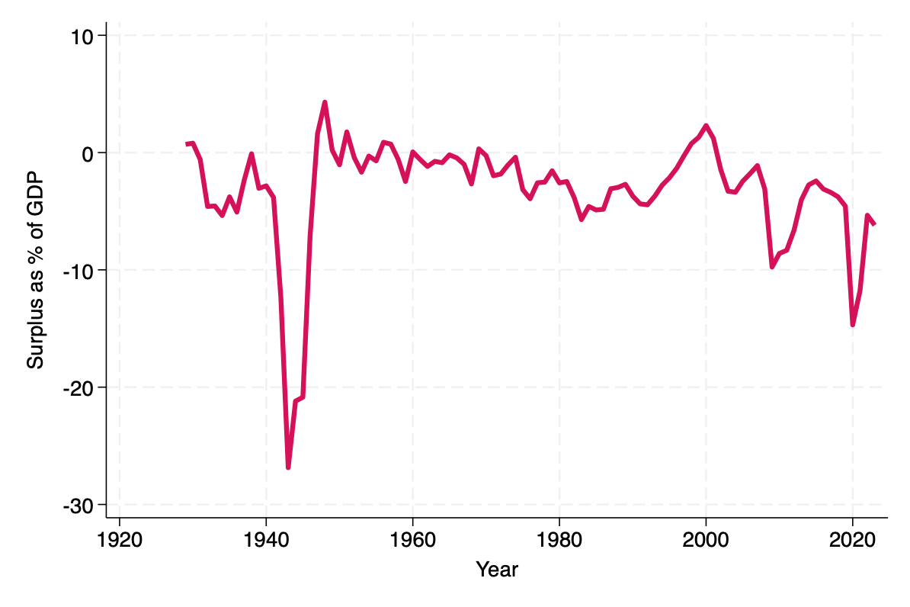
Federal Surplus as a percent of GDP

Slide 5
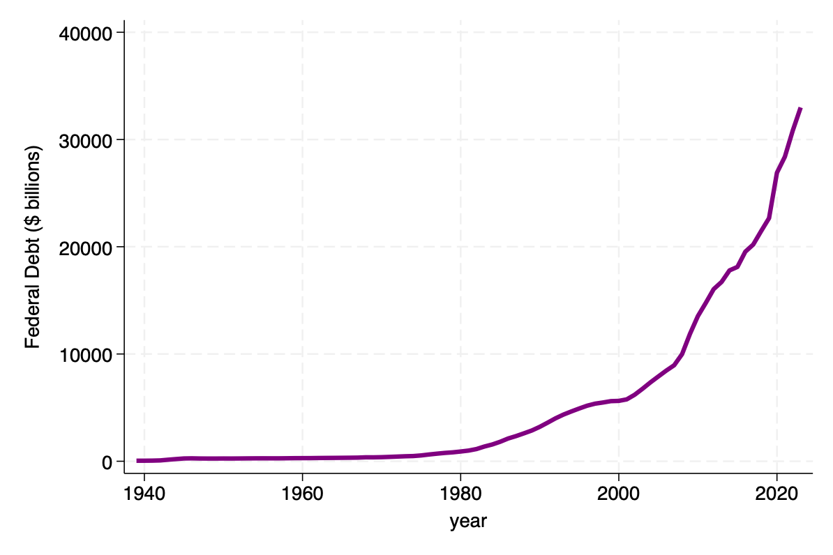
Total Federal Debt

Slide 6
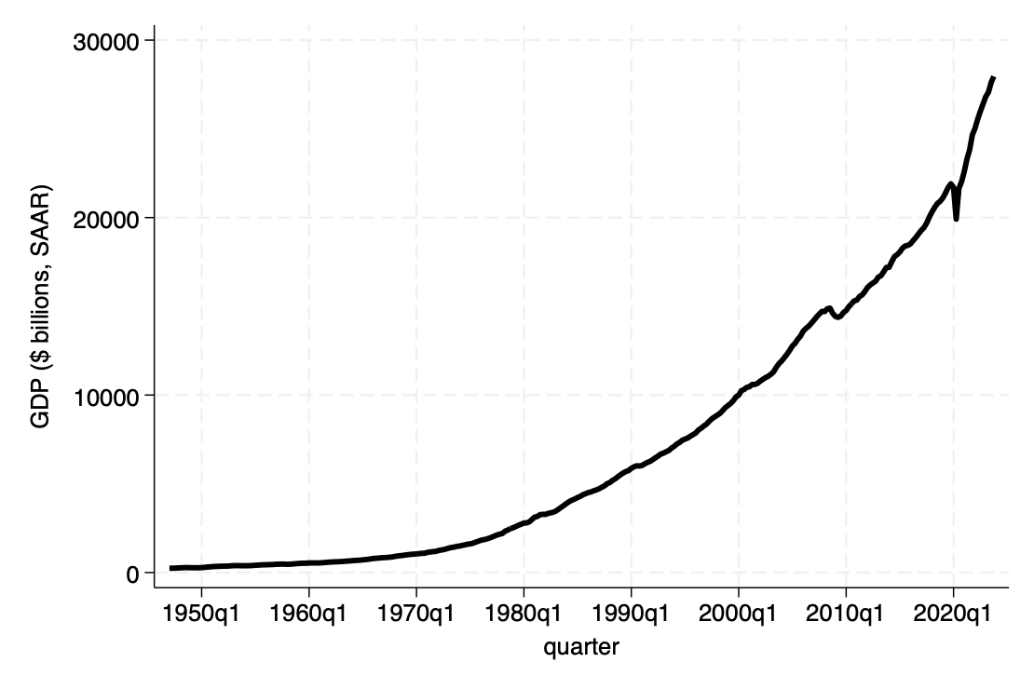
GDP (Nominal)

Slide 7
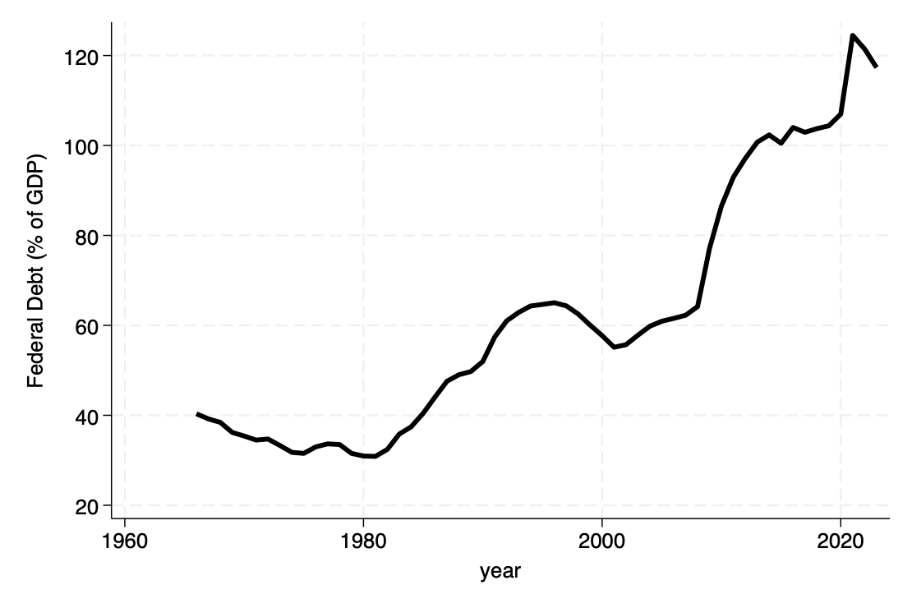
US Debt to GDP ratio

Slide 8
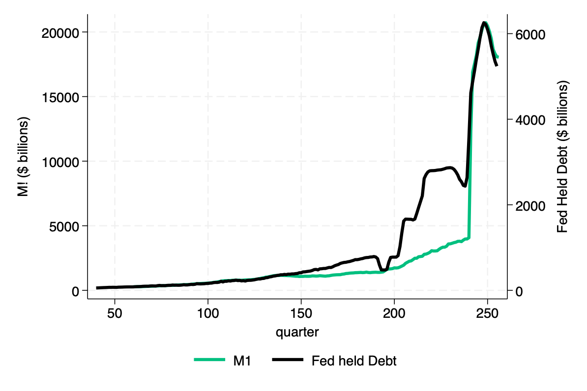
Fed Held Debt and Money Supply

Slide 9
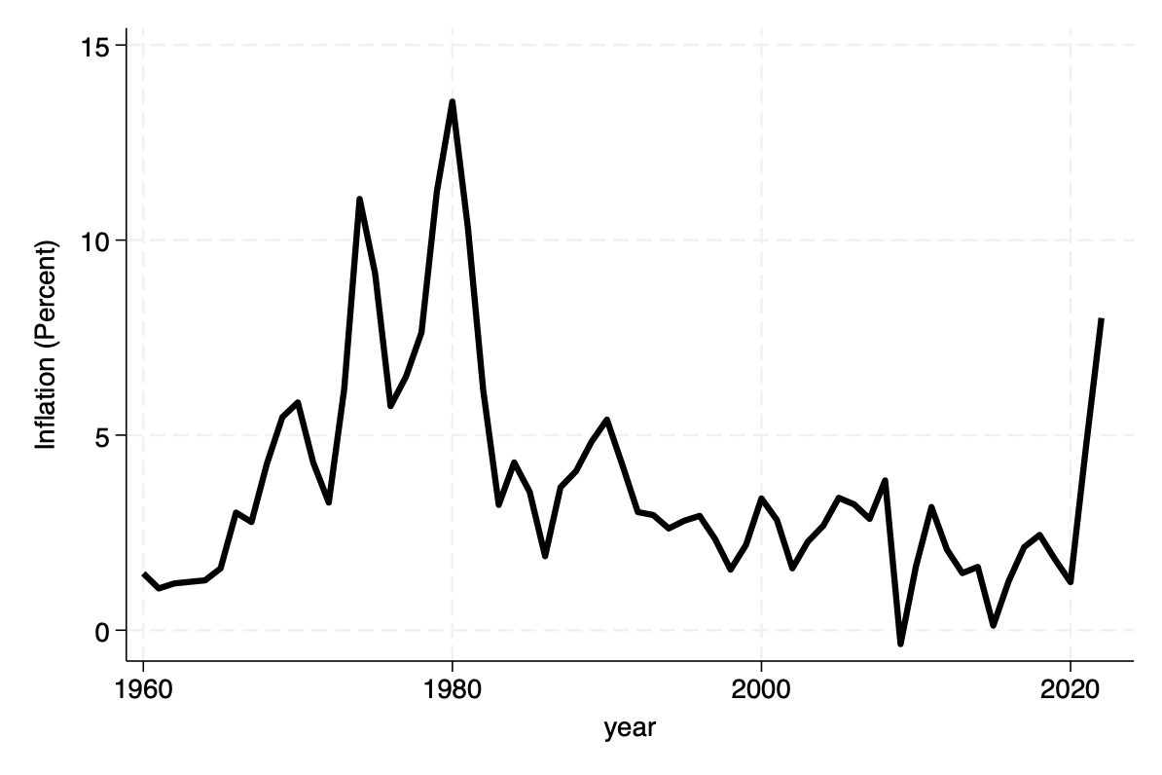
Inflation

Slide 10
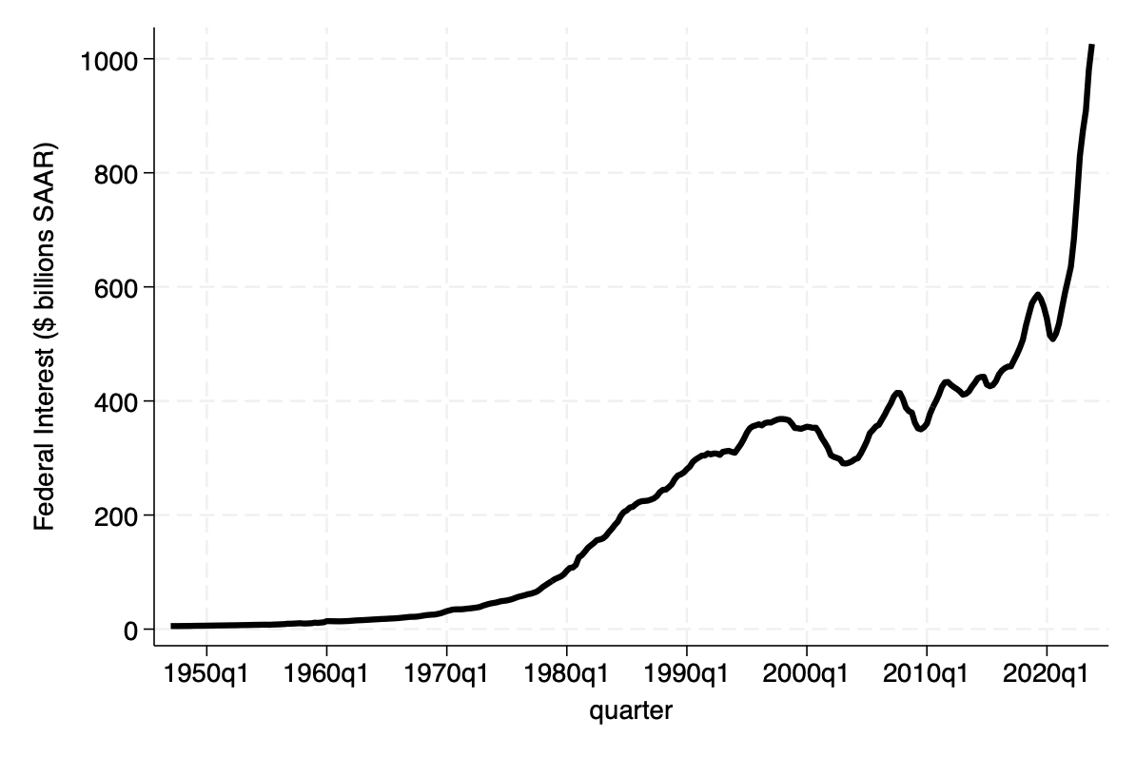
Federal Government Interest Payments

Slide 11
Will AI come to the rescue?
$$\frac{Debt}{GDP}$$

Slide 12
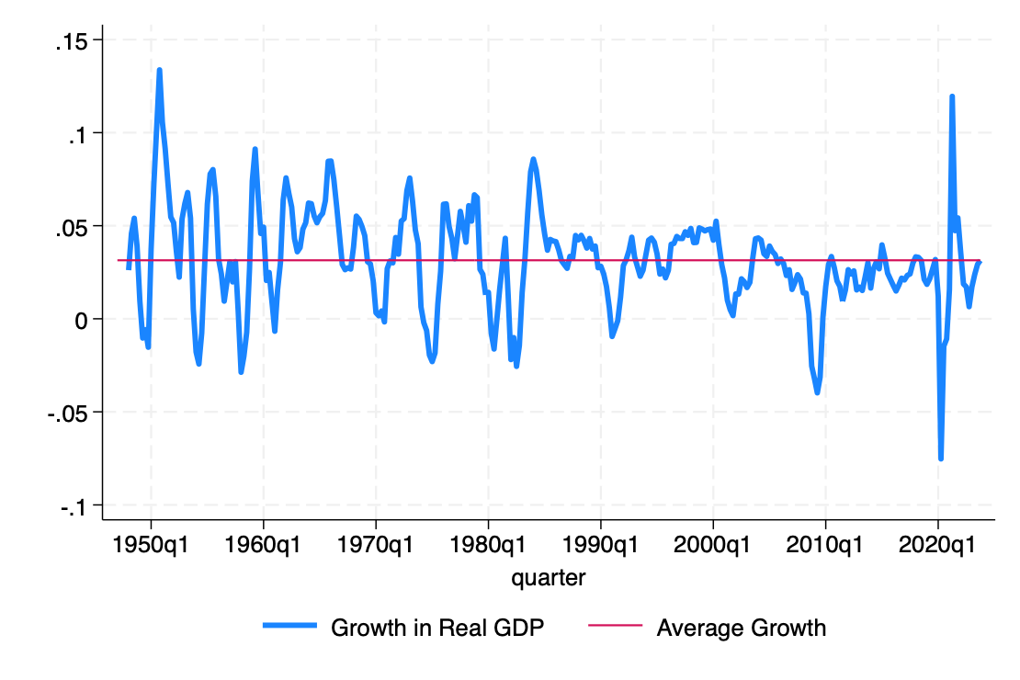
SAAR GDP Growth Quarterly

Slide 13
CBO Forecasts

Slide 14
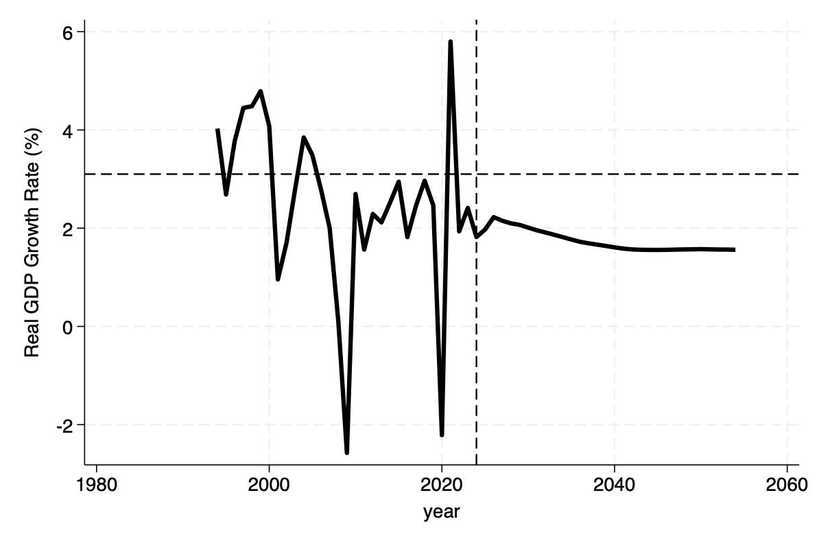
CBO Forecast of Annual GDP Growth

Slide 15
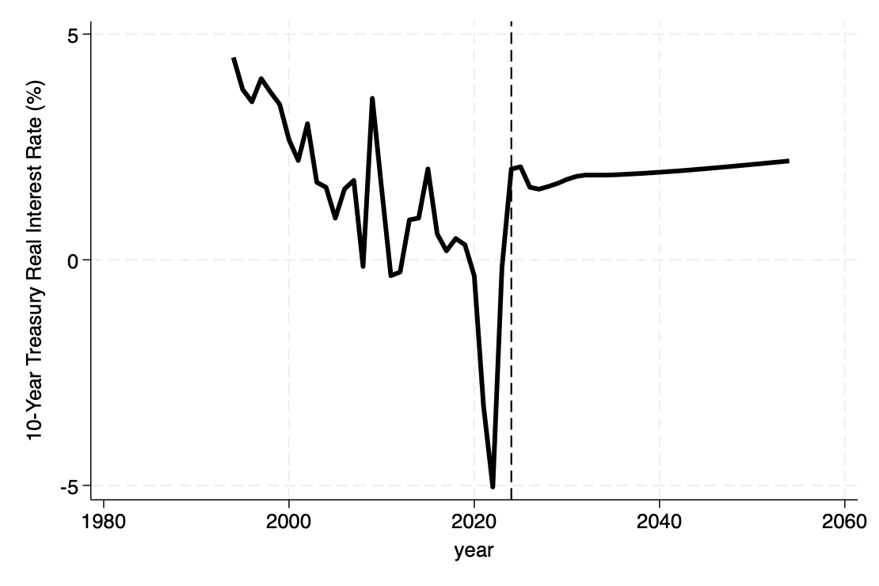
CBO Ten-Year Note Real Rate Forecast

Slide 16
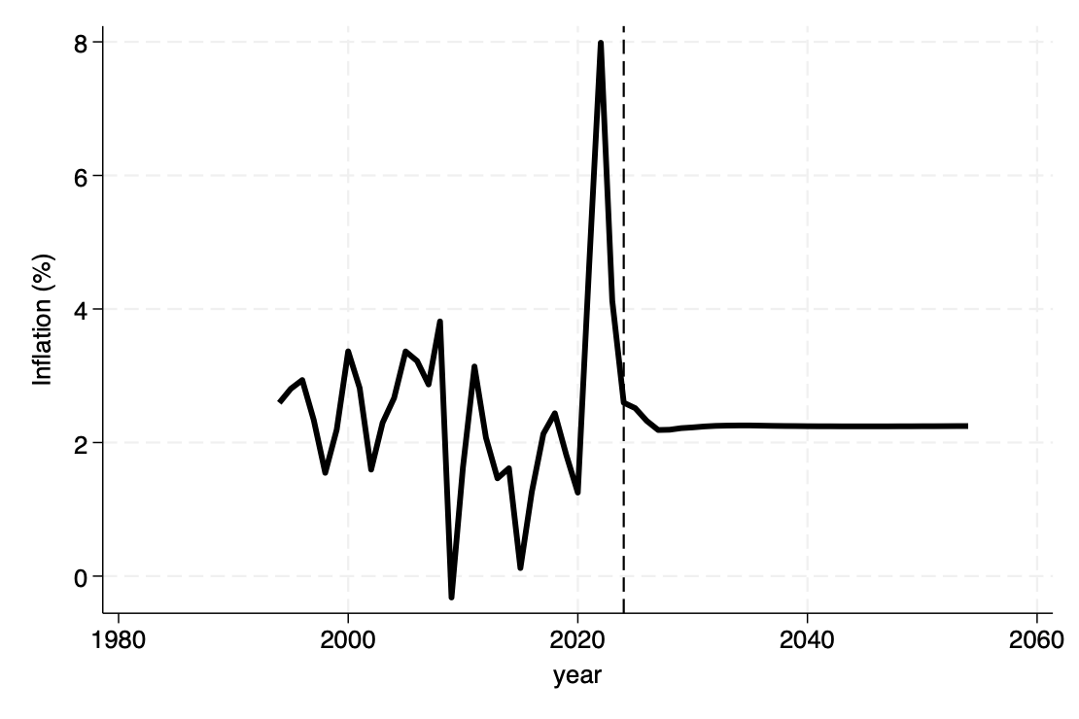
CBO Inflation Forecast

Slide 17
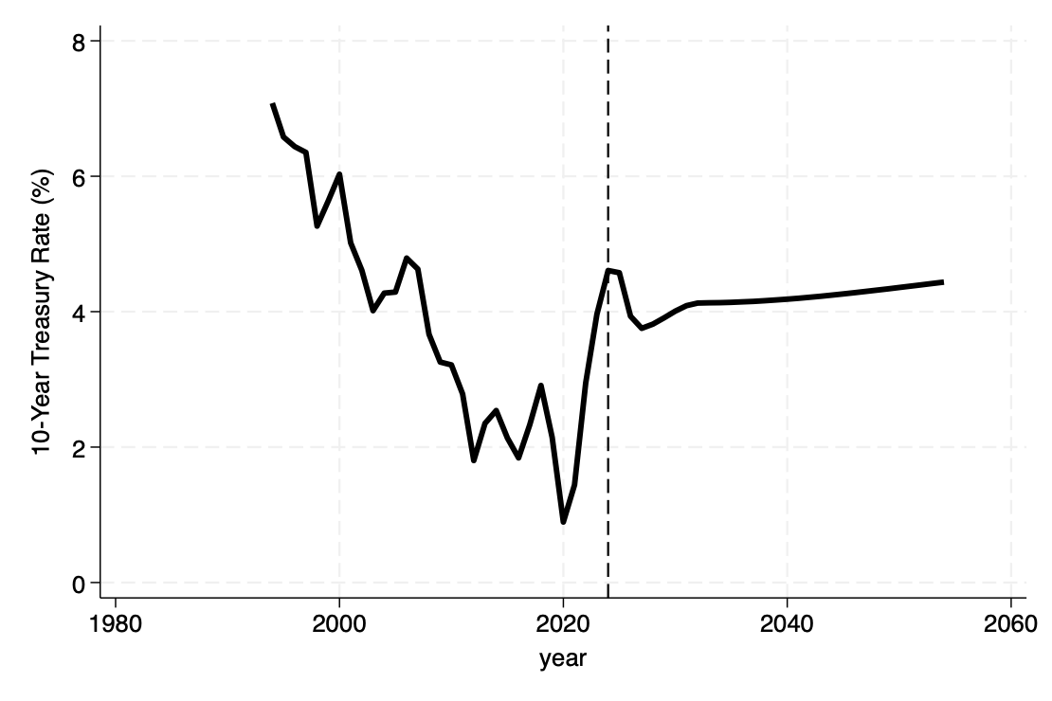
CBO 10-Year Nominal Forecast

Slide 18
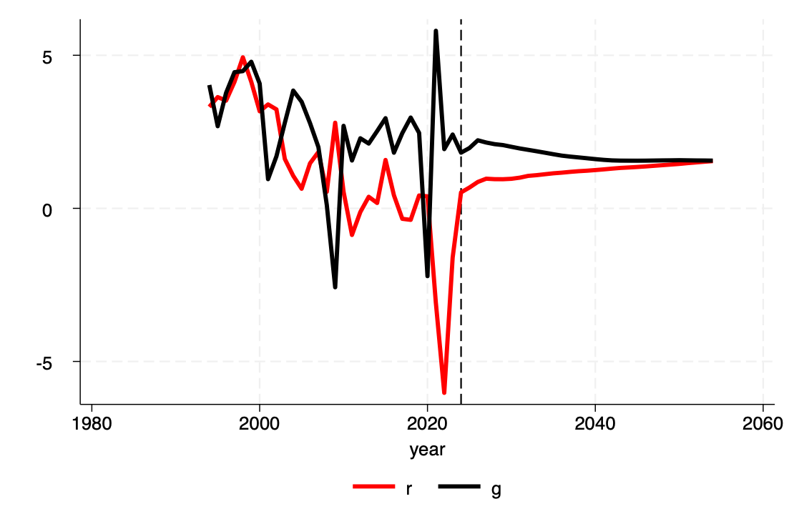
Are Federal Deficits sustainable?

Slide 19
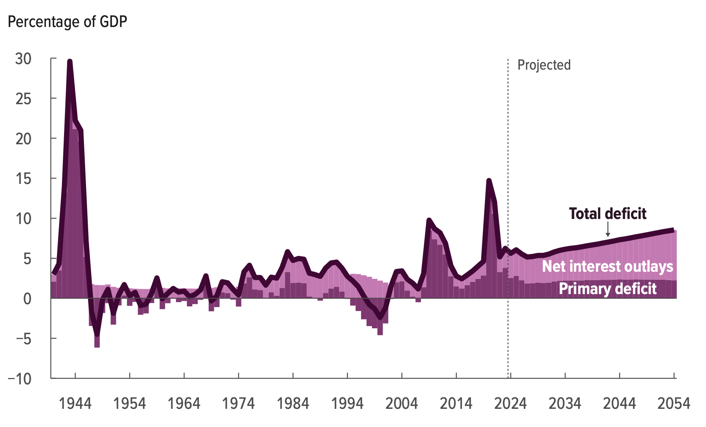
Page 2, CBO’s LTBO Deficits 2024-2054

Slide 20
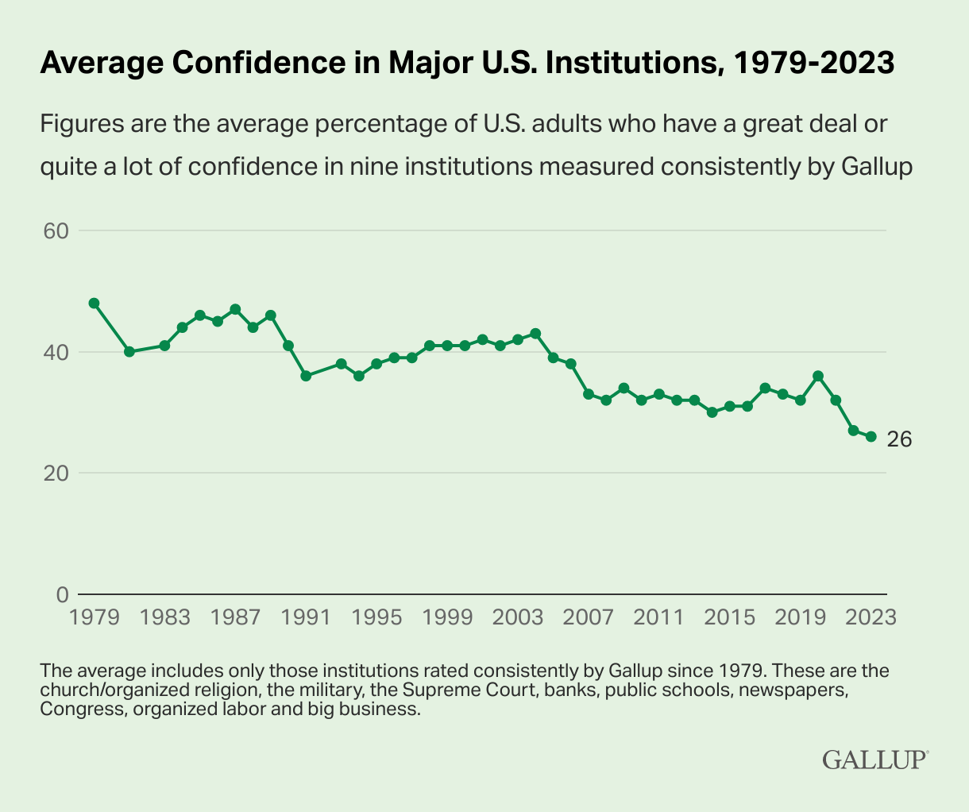
Gallup-Historically Low Faith in U.S. Institutions Continues July 6, 2023

