Slide 1
Carson v. makin, part deux
“Laissez les financement rouler!!”
NAHEFFA – New Orleans, LA
April 9, 2024
Jon Jurich
Seattle, WA
Pacifica Law Group
Cory Kalanick
Denver, CO
Sherman & Howard
Fred Marienthal
Denver, CO
Kutak Rock

Slide 2
Course catalog
LAW 103 – Carson v. Makin: The Refresher Course
POL SCI 201 – Makin Moves: Subsequent Developments and Current Events
BONDS 301 – Considerations in Financings: Financing Religiously Affiliated Facilities (Symposium)
ART 301 – Issues for Issuer’s Counsel
QUAD 400 – Questions and Conversations

Slide 3
law 103 – carson v. makin

Slide 4
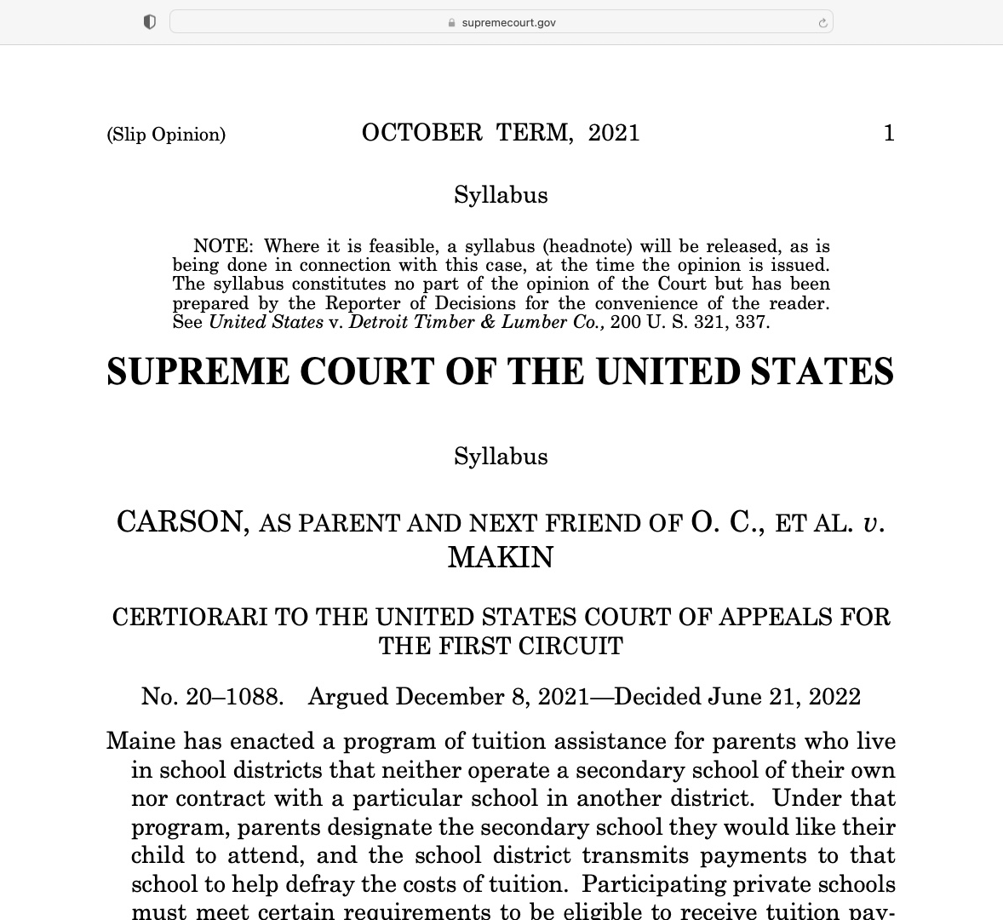
Law 103 – Carson v. makin

Slide 5
Carson V. MAKIN and the 1st amendment
The Establishment Clause
The Free Exercise Clause
“Congress shall make no law respecting an establishment of religion”
“[Congress shall make no law] prohibiting the free exercise thereof”

Slide 6
Carson V. MAKIN and the 1st amendment
Carson’s Arguments
Makin’s Arguments
Tuition assistance did not go to the schools, it went to the parents
Prohibition on how parents used that money violates the Free Exercise clause
Law did not require public-school equivalent education (particularly as some private schools charged more than the benefit)
State could only provide money for public-school equivalent education
Use-based restrictions do not cause the same issues as restrictions based on religious status
Prior case law (Locke v. Davey) authorized denials based on an anticipated religious use

Slide 7
Carson V. MAKIN
Supreme Court ruled:
Generally applicable statutes that impose restrictions based on religion are subject to strict scrutiny
Analysis examines whether governmental action (1) advances compelling state interest and (2) is narrowly tailored to fit that interest
Maine had no compelling state interest – there was no historic and substantial tradition against aid for people attending private religious schools
Once the state started subsidizing any private education, it cannot distinguish among private schools based on whether they are religious schools

Slide 8
Carson V. MAKIN
“Pervasively Sectarian”
Post – Makin
Line of cases that focused on “how religious” an institution was, and
How closely the law / program in question was to advancing / inhibiting religious use
Generally, the Court seemed focused on the Establishment Clause
Focus shifts to Free Exercise clause
Clarifies that restrictions on religious status / use for generally available programs are subject to strict scrutiny
Analysis examines whether governmental action (1) advances compelling state interest and (2) is narrowly tailored to fit that interest

Slide 9
Carson V. MAKIN
After Carson v. Makin, issuers and lawyers had to re-examine their analysis of financings for religiously affiliated borrowers
Expanded the range of facility owners who could be eligible to use tax-exempt financing without violating the First Amendment
Previously moot questions of whether state law allowed conduit issuers to finance certain facilities (and borrowers) had to be evaluated and addressed
Restrictions in statutes, policies and bond documents all had to be revisited and evaluated against an unclear future

Slide 10
Carson V. MAKIN & opinions
Why the public finance lawyers really care: bond counsel deliver unqualified opinions.
Qualified opinions include (i) non-customary assumptions, limitations, or qualifications, (ii) phrases such as “while the matter is not free from doubt,” or (iii) legal analysis explaining the opinion (i.e., a reasoned opinion).
Unqualified opinions are only subject to customary assumptions, limitations, and qualifications, and are not otherwise explained
“Interest on the Bonds is excludable from gross income for federal income tax purposes and is not an item of tax preference for purposes of the federal alternative minimum tax imposed on individuals ….”
In order to render an unqualified opinion regarding the validity or tax-exemption of bonds, counsel must be firmly convinced (i.e., have a high degree of confidence) that, under the law in effect on the date of the opinion, the highest court of the relevant jurisdiction, acting reasonably and properly briefed on the issues, would reach the legal conclusions stated in the opinion.

Slide 11
Poli sci 201 – makin moves

Slide 12
MAKIN Moves: what came next
In the same term as Carson v. Makin, the Supreme Court made several other rulings related to the First Amendment:
Kennedy v. Bremerton School District (2022): Decision published less than one week after Carson held that district violated Free Exercise and Free Speech clauses of First Amendment for disciplining coach who prayed by himself after football games
303 Creative LLC v. Elenis (2022): Just three days after publishing Kennedy, the Court overturned the district and appellate courts in ruling the Colorado Anti-Discrimination Act would violate a website designer’s Free Speech rights if the law were interpreted to force her “to create websites celebrating marriages that defy her belief that marriage should be reserved to unions between one man and one woman.”

Slide 13
MAKIN Moves: subsequent issues
The Free Exercise clause and state law issues:
Crosspoint Church v. Makin (D. Maine February 27, 2024): The district court denied a request for an injunction against the state enforcing certain provisions of the Maine Human Rights Act’s Antidiscrimination Provisions.
Plaintiff Crosspoint Church runs one of the schools at issue in Carson v. Makin.
While Carson was pending, Maine legislature also amended the law in question to add gender identity, religion, ancestry and color as protected classes and narrowed the religious exemption from the statute to only religious organizations that do not receive public funding.
“Recognizing that this case presents novel constitutional questions in the wake of the Supreme Court’s decision in Carson v. Makin, the Court has framed its opinion as a prelude to a challenge to the … First Circuit for a more authoritative ruling.”

Slide 14
MAKIN Moves: current events
The Free Exercise clause and state law issues:
Oklahoma’s Religious Charter School Case is pending:
In June 2023, the Oklahoma Statewide Virtual Charter School Board approved a Catholic virtual charter school.
The Oklahoma Attorney General warned the school would violate both the Oklahoma and U.S. Constitutions, and brought a suit in October 2023 after the board entered into a contract for the charter school.

Slide 15
Bonds 301 – considerations in financings
Financing Religiously Affiliated Facilities
(Symposium)

Slide 16
Considerations in financings
What are the issues that concern YOU the most on a day to day basis?
What has changed at a practical level in bond financings since Carson v. Makin was decided in 2022?
What are the conversations conduit issuers need to be thoughtful about?
What are the grey areas that bond counsel are concerned about?

Slide 17
art 301 – issues for issuer’s counsel

Slide 18
Issues for issuer’s counsel
What are the issues that concern YOU the most on a day to day basis?
What unique questions should conduit issuers be asking their issuer or general counsel?
What practical steps should be taken to address the changes that are happening since the Carson v. Makin decision?

Slide 19
To Finance, Or Not To Finance… That is the Question
No
Free Exercise Challenge?
Yes
Shifts Burden to Bond Counsel
Maybe
Relaxed standard, but…
No to worship space or other areas of “historic and substantial tradition” against aid?
Establishment Clause Challenge?
Borrower indemnifications

Slide 20
Old Financing Guidelines

Slide 21
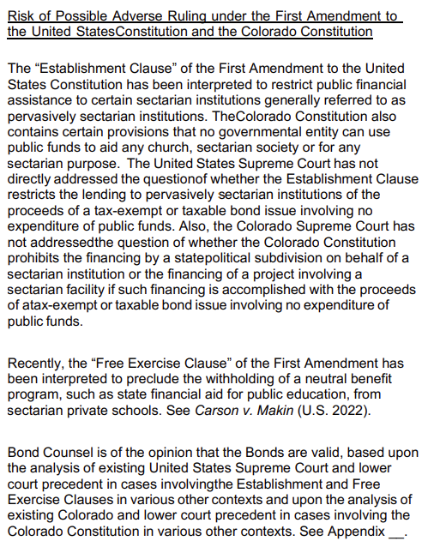
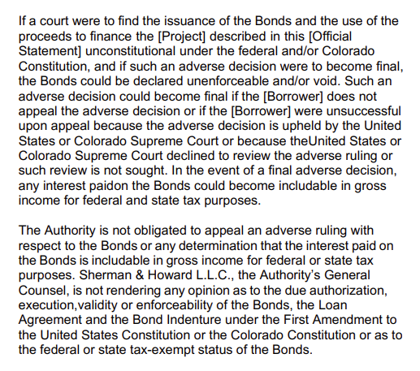
Disclosure

Slide 22
quad 400 – questions and conversations
Jon Jurich
Pacifica Law Group
(206) 245-1717
Jon.Jurich@pacificalawgroup.com
Cory Kalanick
Sherman & Howard
(303) 299-8373
ckalanick@sherman howard.com
Fred Marienthal
Kutak Rock
(303) 292-7817
Frederic.Marienthal@kutakrock.com

